Slide 1
BÜYÜK VERİ İŞLEME TEKNİKLERİ VE UYGULAMALARI
NOAA GHCN-Daily Big-Data Analysis
on a Distributed Spark + Hadoop Cluster
Processing 90 million real weather observations on a 9-container distributed architecture (Spark, Hadoop, Hive, RStudio)
PREPARED BY
COURSE INSTRUCTOR
ABDULLAHI Mohamed Abdullah
Assist. Prof. Dr. Ömer Faruk Acar
Student No: 2528190501
Dataset: NOAA GHCN-Daily 2020–2024 • Apache Spark 3.2 · Hadoop HDFS · Hive · Parquet · sparklyr · ggplot2 · Docker

Slide 2
01
Project Objective
Build a fully distributed big-data pipeline that ingests, processes, and analyses a real, large-scale public dataset using industry-standard infrastructure components.
Distributed Architecture
Real Big Data
1
2
Build a 9-container cluster: HDFS + Spark + Hive + RStudio + Docker Compose.
Use a genuine large-scale public dataset — not synthetic or toy data.
Columnar Storage
Distributed Compute
3
4
Convert raw CSV to Snappy-compressed Parquet, partitioned by year on HDFS.
Run Spark ETL across two parallel worker nodes.
Interactive Analysis
Defensible Results
5
6
Query the data from RStudio via sparklyr and produce publication-quality plots.
Three quantitative climate analyses with reproducible outputs.

Slide 3
02
The Dataset: NOAA GHCN-Daily
Source. NOAA's Global Historical Climatology Network – Daily (GHCN-Daily), the primary international climate-research dataset. Downloaded from the official NOAA-AWS Open Data mirror at noaa-ghcn-pds.s3.amazonaws.com.
90,744,056
rows after quality filtering
Scope. Five years of global daily observations (2020–2024) from 100,000+ meteorological stations worldwide.
~756 MB
Elements. TMAX (max temperature), TMIN (min), PRCP (precipitation). Temperature is recorded as integer tenths of a degree Celsius.
compressed (.csv.gz) raw size
5 years
Quality. QC-flagged records (Q-FLAG present) are excluded during ETL, ensuring only validated observations enter the analysis.
annual files 2020–2024
100,000+
global weather stations

Slide 4
03
System Architecture — 9 Docker Containers
HDFS STORAGE TIER
SPARK COMPUTE TIER
CATALOG & ANALYSIS TIER
namenode
spark-master
hive-metastore
HDFS Master
Cluster manager
Schema catalog — Thrift :9083
datanode1
spark-worker-1
postgres
Block storage — replica 1
2 cores · 1.5 GB executor
Metastore database
datanode2
spark-worker-2
rstudio
Block storage — replica 2
2 cores · 1.5 GB executor
RStudio Server :8787 — sparklyr + ggplot2
Replication factor: 2
Files partitioned by year
Snappy-compressed Parquet
PySpark ETL + sparklyr
4 cores · 3.0 GB total
Kryo serializer
Web UIs exposed: HDFS :9870, Spark :8080
Docker Compose orchestration
Each tier is independently scalable. Data flows: HDFS → Spark Workers → sparklyr in RStudio. Schema is registered in Hive Metastore (backed by PostgreSQL).

Slide 5
04
Technology Stack
Industry-standard open-source big-data tooling. Every component is production-ready and used by major data platforms worldwide.
Apache Spark 3.2.1
Apache Hadoop HDFS 3.2
Distributed in-memory compute engine.
1 master + 2 workers, 4 cores, 3 GB total.
Distributed file system. 1 NameNode + 2 DataNodes with replication factor 2.
Apache Hive Metastore
PostgreSQL 11
Schema catalog over HDFS. Allows SQL queries on Parquet data.
Relational backing store for the Hive Metastore service.
Apache Parquet + Snappy
sparklyr + dplyr + ggplot2
Columnar binary format with fast compression. Partitioned by year.
R interface to Spark. Cluster-scale data analysis from RStudio.
RStudio Server 4.3.2
Docker Compose
Browser-based R IDE running inside Docker.
9-container orchestration on a single host.

Slide 6
05
ETL Pipeline — CSV → Parquet on HDFS
PySpark job parses 5 yearly gzipped CSVs, applies quality checks, derives time features, and writes a columnar dataset partitioned by year on HDFS.
1
Ingest
2
Parse
3
Clean
4
Enrich
5
Persist
5 yearly
.csv.gz files
on HDFS
8-column NOAA
schema with
typed fields
Drop QC-flagged
rows
Keep TMAX/TMIN/PRCP
Derive year /
month / day /
date fields
Snappy Parquet
partitioned by year
on HDFS (2× replicated)
PIPELINE RESULT
Stored as 5 year-partitioned Parquet directories under /user/hive/warehouse/weather.db/noaa_observations/year={2020,2021,2022,2023,2024}
Replicated across both DataNodes. Snappy compression.
90,744,056
rows of validated NOAA observations

Slide 7
06
Result 1 — Annual Temperature Trend
READING THE CHART
Five years of data, averaged over 100,000+ global stations: • 2020 → 2021 small dip (16.9 → 16.8 °C) • 2021 → 2022 sharp rise (16.8 → 17.9 °C) • 2023 minor pullback (17.1 °C) • 2024 rebound to 17.7 °C Overall trend: upward over the 5-year window despite year-to-year variation. The linear regression overlay in the RStudio plot quantifies this slope.
Methodology note: Each datapoint is the unweighted mean of every valid TMAX observation worldwide that year. Bias toward northern-hemisphere station density is acknowledged.

Slide 8
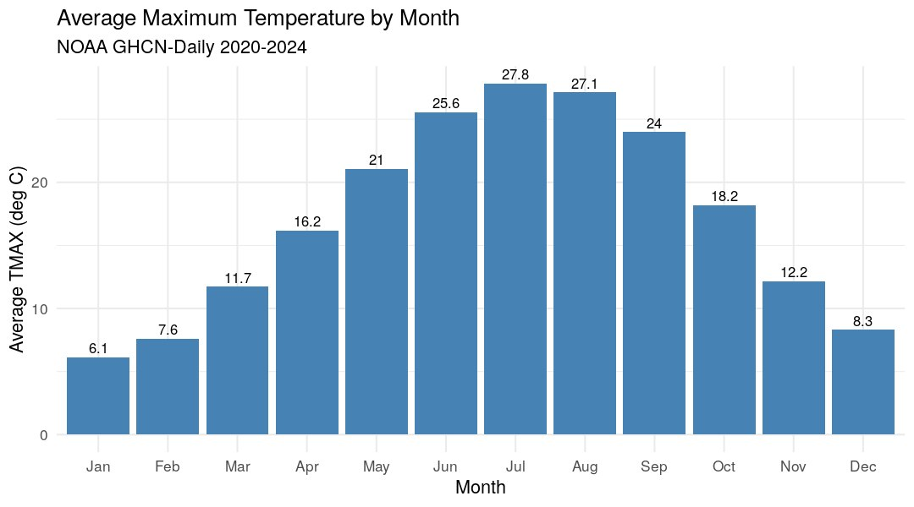
07
Result 2 — Monthly Seasonality
WHAT THE PLOT SHOWS
Average TMAX aggregated across all years, by calendar month. Expected pattern: a clear Northern-Hemisphere-dominated seasonal cycle — trough around January/February, peak around July/August. Why? Most GHCN-Daily stations are in North America, Europe, and Asia. The unweighted global mean is therefore biased toward NH seasons. Computed by Spark across all 90.7M rows, with the small monthly summary collected back to R for ggplot rendering.

Slide 9
08
Result 3 — Extreme-Heat Days
THE HEADLINE NUMBER
+40 %
rise in extreme-heat days
2022 → 2024 (139,889 → 196,501)
An extreme-heat station-day is any station/date with TMAX > 35°C (i.e. > 350 in NOAA's tenths-of-a-degree units). After a dip in 2022, frequency rose sharply for two consecutive years, finishing at the highest count in the 5-year window. This aligns with widely reported global heat records in 2023 and 2024.

Slide 10
09
Defense — Anticipated Questions
Q. Is the data synthetic?
Q. Why this dataset?
A. No. 90.7 million real measurements from NOAA GHCN-Daily, downloaded from the official NOAA-AWS Open Data mirror. Same source used in published climate research.
A. Large-scale (10⁸ rows in this slice, 10⁹+ in the full archive), free, well-documented, scientifically meaningful. A real big-data problem, not a toy.
Q. Is the system actually distributed?
Q. Why Parquet over CSV?
A. Yes. Two HDFS DataNodes with replication factor 2. Two Spark Workers executing in parallel. Hive Metastore as a separate service backed by PostgreSQL. 9 containers, demonstrable via the running web UIs.
A. Columnar storage with Snappy compression: smaller files, fast scans of subsets of columns. Year-based partitioning enables partition pruning so queries skip entire files.
Q. Why Spark instead of Pandas?
Q. What analyses did you run?
A. Pandas would have to load all ~6 GB uncompressed into a single machine's RAM. Spark distributes the work across workers — each handles a partition, only the small aggregated result returns to the driver.
A. Annual TMAX trend with linear regression, monthly seasonality, and extreme-heat day count per year. All run from RStudio via sparklyr against the Hive-warehouse-located Parquet.

Slide 11
Conclusion & Future Work
End-to-end pipeline delivered
90.7 M
Real NOAA data ingested, processed in parallel on Spark, persisted as Parquet on HDFS, and analysed interactively from RStudio — every layer of a modern big-data stack.
90 million rows on a single workstation
validated rows processed
across 2 Spark workers
9-container distributed cluster orchestrated by Docker Compose. 4 cores and 3 GB total Spark memory handled the full ETL in ~30 minutes.
Defensible scientific output
Future improvements
Annual trend, seasonality, and extreme-heat counts — all reproducible from the same Parquet warehouse with the same R script.
Extend to the full GHCN-Daily archive (100+ years)
Add station-metadata join for geographic analyses
Deploy on multi-node Kubernetes with YARN
Spark MLlib for forecasting / regression on TMAX
Architecture that scales
Replace single-host docker-compose with a multi-node Kubernetes deployment and the same code processes terabytes.
Thank you • Questions welcome

